Slide 1

Team Name: CodeCatalysts
Team Members: Apoorva Holkar
Priyanka Lokhande
Shruti Dikkar

Slide 2
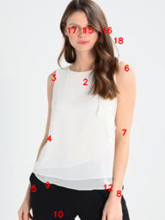
Trend forecasting
Our website features a "Trending" section that highlights products gaining significant user interest.
When multiple users search for the same product and the search volume surpasses a predefined threshold, the product is marked as trending.
This section is updated in real-time, ensuring users have access to the most current and popular items.

Slide 3




User one
User two
User three
User four
User five
Search for product
Search for product
Search for product
Search for product
Search for product
Trending

Slide 4
Smart Search
Our website features a "Smart Search" functionality that allows users to search for products using images.
By simply uploading a picture, users can find exact matches or similar items available on our platform.

Slide 5


Smart Search Process
User
Upload a image
Product
Image recognition

